Slide 1
Accelerating the Transition to Medium and Heavy Duty Zero Emission Trucks
Sydney Vergis, PhD
Division Chief, California Air Resources Board
sydney.vergis@arb.ca.gov

Slide 2

Mission
Leads California’s fight against air pollution and climate change
Protects public health, and promotes environmental justice, social equity, & sustainable communities
Promotes clean, energy-efficient fuels and technology

Slide 3
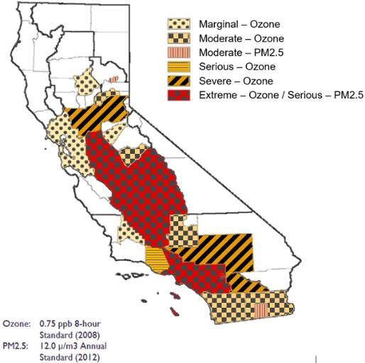
California’s Air Quality Challenge
California Ozone and PM2.5 Non-Attainment Areas
California has the worst air quality in the United States
Key challenges in southern California
Heavy-duty trucks and federal sources remain largest contributors

Slide 4
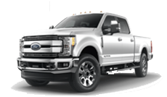
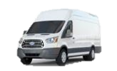
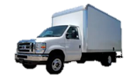

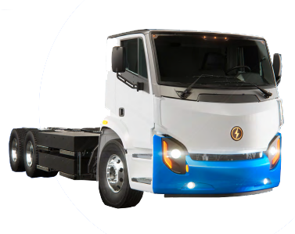
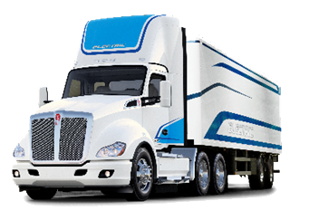
Commercially Available BEV Models in California
More than 500 ZEV models available worldwide.

Slide 5
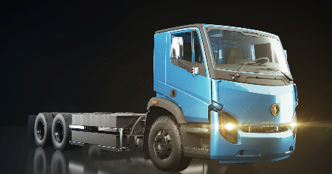
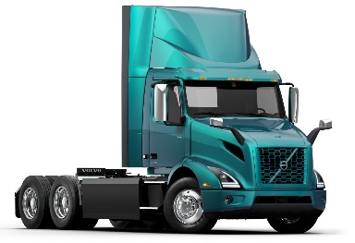
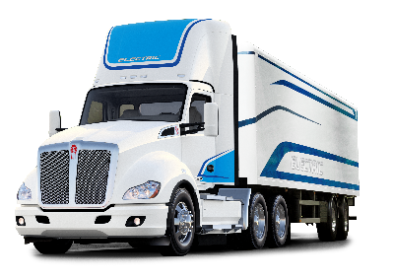
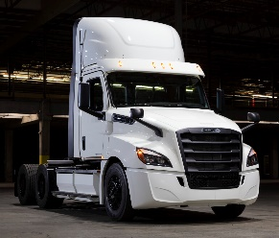
ZE Tractor Commercial Availability
Available Today in CA
2022
2023
  BYD 8TT
  Freightliner eCascadia
  Kenworth T680E
  Lion Electric LION8
  Nikola TRE
  Peterbilt 579
  Volvo VNR Electric
  Hyzon FCET8
  Nikola One/Two Fuel Cell
  Tesla Semi
  Hyundai XCIENT Fuel Cell
  XOS HDXT

Slide 6
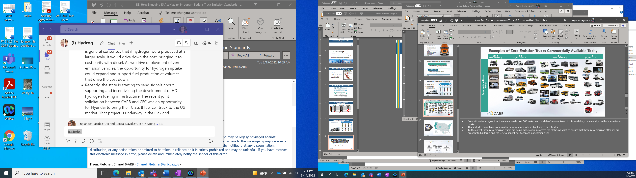
Advanced Clean Trucks (ACT) Regulation
Model Year (MY) | Class 2b-3 | Class 4-8 | Class 7-8 Tractors
2024 | 5% | 9% | 5%
2025 | 7% | 11% | 7%
2026 | 10% | 13% | 10%
2027 | 15% | 20% | 15%
2028 | 20% | 30% | 20%
2029 | 25% | 40% | 25%
2030 | 30% | 50% | 30%
2031 | 35% | 55% | 35%
2032 | 40% | 60% | 40%
2033 | 45% | 65% | 40%
2034 | 50% | 70% | 40%
2035+ | 55% | 75% | 40%
Manufacturer ZEVs as a percentage of annual sales
Begins with 2024 model year

Slide 7
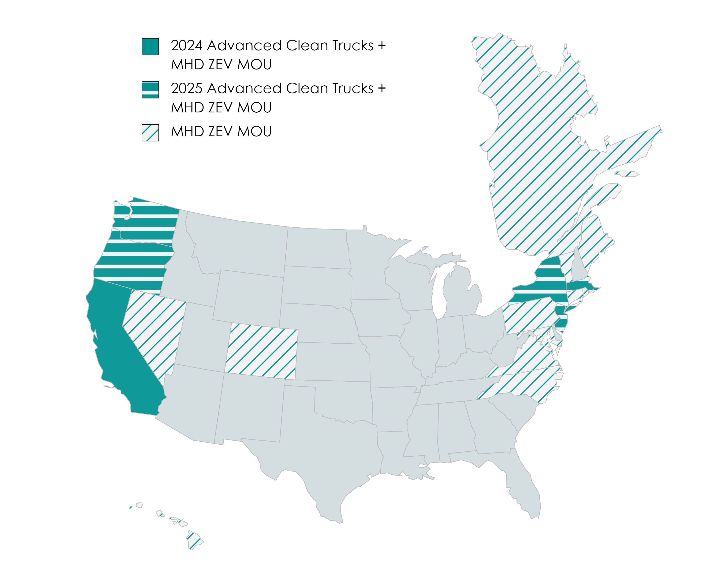
20% of the U.S. Truck Market is Going Zero

Slide 8
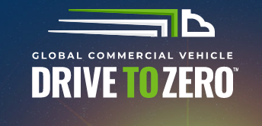


International ZET Collaborations

Slide 9
Thank you

